Slide 1
Siemens Step 7 TIA Portal

Slide 2
Table of Contents
Introduction
Project Migration
Hardware / System Architecture
Hardware Configuration
Program Elements
Configuring Remote I/O
Error Handling and Troubleshooting
Project Management Tools
Tips and Tricks

Slide 3
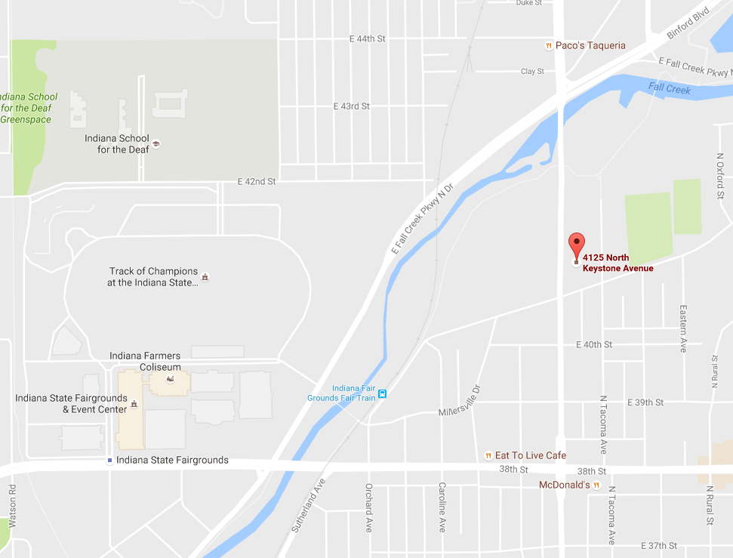
Introduction
Miller-Eads Automation is an industrial automation and controls integration company. We specialize in new and upgrade projects of all sizes. A division of one of Indiana's largest electrical contractors.
Over the course of four decades, Miller-Eads has built an unparalleled reputation as one of the most skilled electrical contractors in central Indiana. With a strong focus on emerging technologies, our talented team is well positioned to meet the future demands of a changing electrical industry.

